Slide 1
Software Systems Design and Integration
Week 4 Lecture Part II:
Threads and Multithreading
1-<number>

Slide 2
LECTURE PLAN
  1 Processes and Threads
    Multitasking vs. Multithreading
    Thread Characteristics
    Benefits of Multithreading
  2 Threads Lifecycle
  3 Multithreading in Java
  4 Multithreading with GUI
1-<number>

Slide 3
Processes and Threads
A thread, sometimes called LWP (Light Weight Process) is a basic unit of CPU utilization
A traditional (Heavy Weight) process has a single thread; multithreaded apps can have many
  Multithreading applications: web browsers with multiple tabs, text editors with multiple windows, chat server with multiple chat rooms, etc.
  Multithreading languages: C/C++, Java, .Net, Python – most of the contemporary general-purpose languages
1-<number>

Slide 4
Lecture Summary
  What we have covered in this lecture:
  Processes vs. Threads
  Threads lifecycle
  Multithreading in Java
  Multithreading with GUI
  Next topic will be:
    Concurrency Control and
    Synchronization
1-<number>

Slide 5
Multitasking Paradigm
Application #1
Local Memory
Operating System
Application #2
Local Memory
Application #3
Local Memory
Shared Memory
1-<number>

Slide 6
Multithreading Paradigm
Application #1
Operating System
Application #2
Thread #1
Local Variables
Java Virtual Machine
Thread #2
Local Variables
Global Memory
Thread #3
Local Variables
1-<number>

Slide 7
Thread Characteristics
Threads have their own:
  Thread ID (identification)
  Program counter (state)
  Register set (data)
  Stack of execution (history)
Threads Share:
  Code – all threads execute the same code
  In-memory data – all threads can share data in the RAM, which requires access control
  External data – the threads can access the same files or databases concurrently, which requires operation synchronization
1-<number>

Slide 8

Single vs. Multithreaded Processes
1-<number>

Slide 9
Benefits of multithreading
Responsiveness: Allow a program to continue running even if part of it is blocked or performing lengthy operations
Resource Sharing: By default, threads share memory resources of the process they belong to.
Economy: Allocating memory and other resources is costly. Threads share resources and are more economical to create, share memory among them and context switch.
Utilization of Multiprocessor Architectures: Distribution of the work among multiple processors (I.e. parallel processes run each thread of the multithreaded application, executed by separate processors).
1-<number>

Slide 10
LECTURE PLAN
  1 Processes vs. Threads
  2 Threads Lifecycle
    States
    Priorities
    Scheduling and Execution
  3 Multithreading in Java
  4 Multithreading with GUI
1-<number>

Slide 11
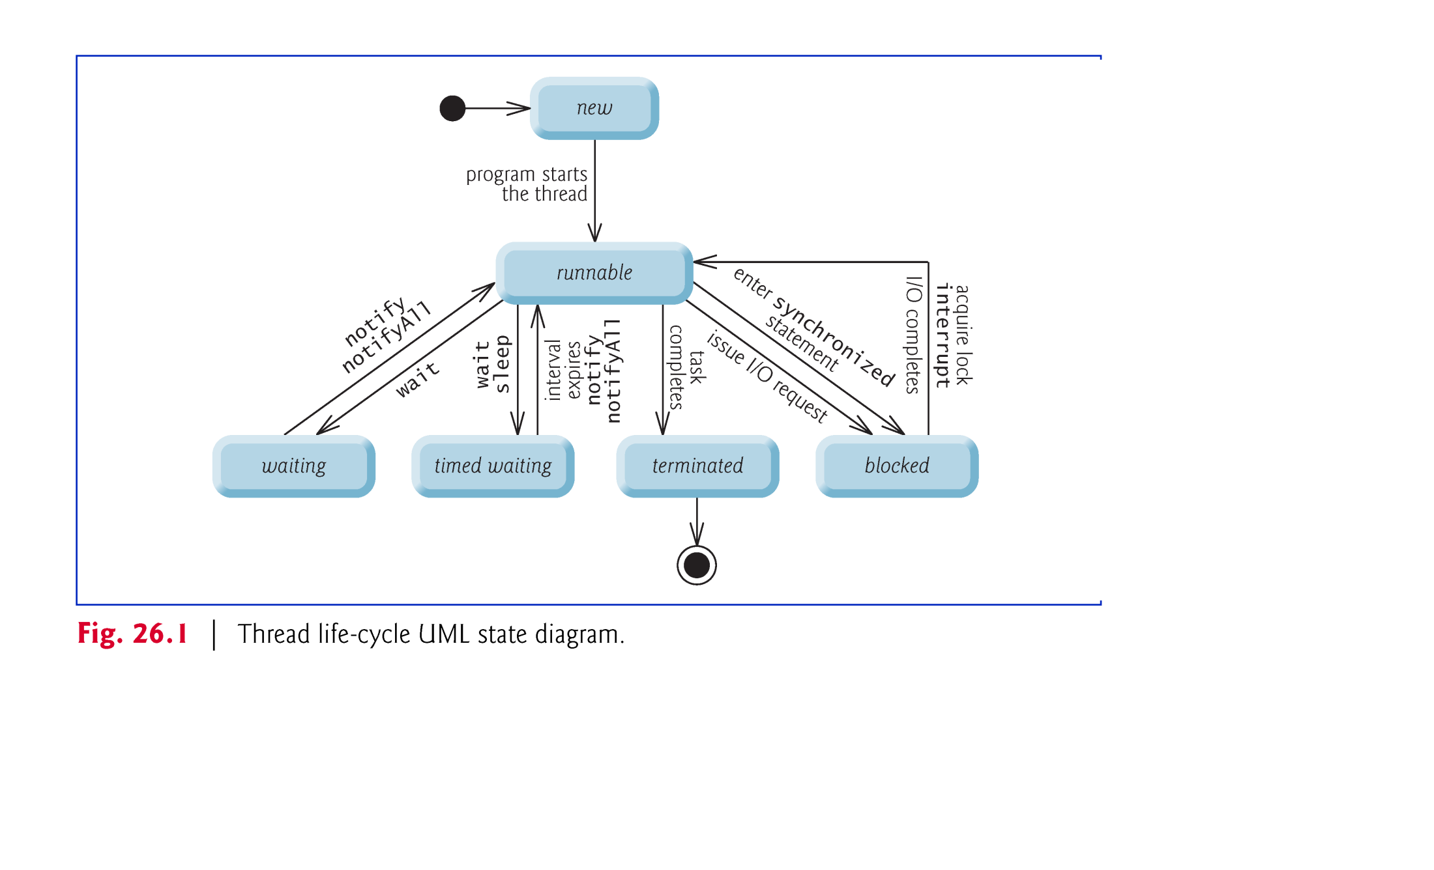
Life Cycle of a Thread
At any time, a thread is said to be in one of several thread states as illustrated in the UML state diagram.

Slide 12
States of a Thread
A new thread begins its life cycle in the new state. It remains there until started, which places it in the runnable state - considered to be executing its task.
A runnable thread can transition to the waiting state while it waits for another thread to perform a task.
  Transitions back to the runnable state only when another thread notifies it to continue executing.
A runnable thread can enter the timed waiting state for a specified interval of time.
  Transitions back to the runnable state when that time interval expires or when the event it’s waiting for occurs.
  Cannot use a processor, even if one is available.

Slide 13
(cont.)
A sleeping thread remains in the timed waiting state for a designated period of time (called a sleep interval), after which it returns to the runnable state.
A runnable thread transitions to the blocked state when it attempts to perform a task that cannot be completed immediately and it must temporarily wait until that task completes.
A runnable thread enters the terminated state when it successfully completes its task or otherwise terminates (perhaps due to an error).
1-<number>

Slide 14
Thread Priorities
Every Java thread has a thread priority that helps determine the order in which threads are scheduled.
Java priorities range between MIN_PRIORITY (a constant of 1) and MAX_PRIORITY (a constant of 10).
By default, every thread is given initial priority NORM_PRIORITY (a constant of 5).
Each new thread inherits the priority of the thread that created it.

Slide 15
Execution Plan
Ready threads
Thread.MAX_PRIORITY
Priority 10
A
B
Priority 9
C
Priority 8
Priority 7
D
E
F
Priority 6
G
Thread.NORM_PRIORITY
Priority 5
H
I
Priority 4
Priority 3
Priority 2
J
K
Thread.MIN_PRIORITY
Priority 1

Slide 16
LECTURE PLAN
  1 Processes vs. Threads
  2 Thread Characteristics
  3 Multithreading in Java
    Threads in Java and OS
    Using Class Thread
    Using Runnable Interface
  4 Multithreading with GUI
1-<number>

Slide 17
Multithreading in Java
So far, our programs mostly use only one thread
  only one thing can happen at a time, and events happen in a sequence determined solely be the code sequence
Java can have several threads running “at the same time”
  several threads running through different code are active - “parallel” threads
  multithreading allows you to run several programs “at the same time” on your PC – “concurrent” execution
1-<number>

Slide 18
Java Threads
What are the threads in Java?
  Flows of control across the code
  Forked from the main process of execution
Two types of Thread
  Implement Runnable interface
  Extend Thread class
Multithreaded programming
  Multiple threads from the same Thread instance
  Threads share same data and code
Starting a Thread
  Using the start() method
  Placing the thread in runnable state
1-<number>

Slide 19
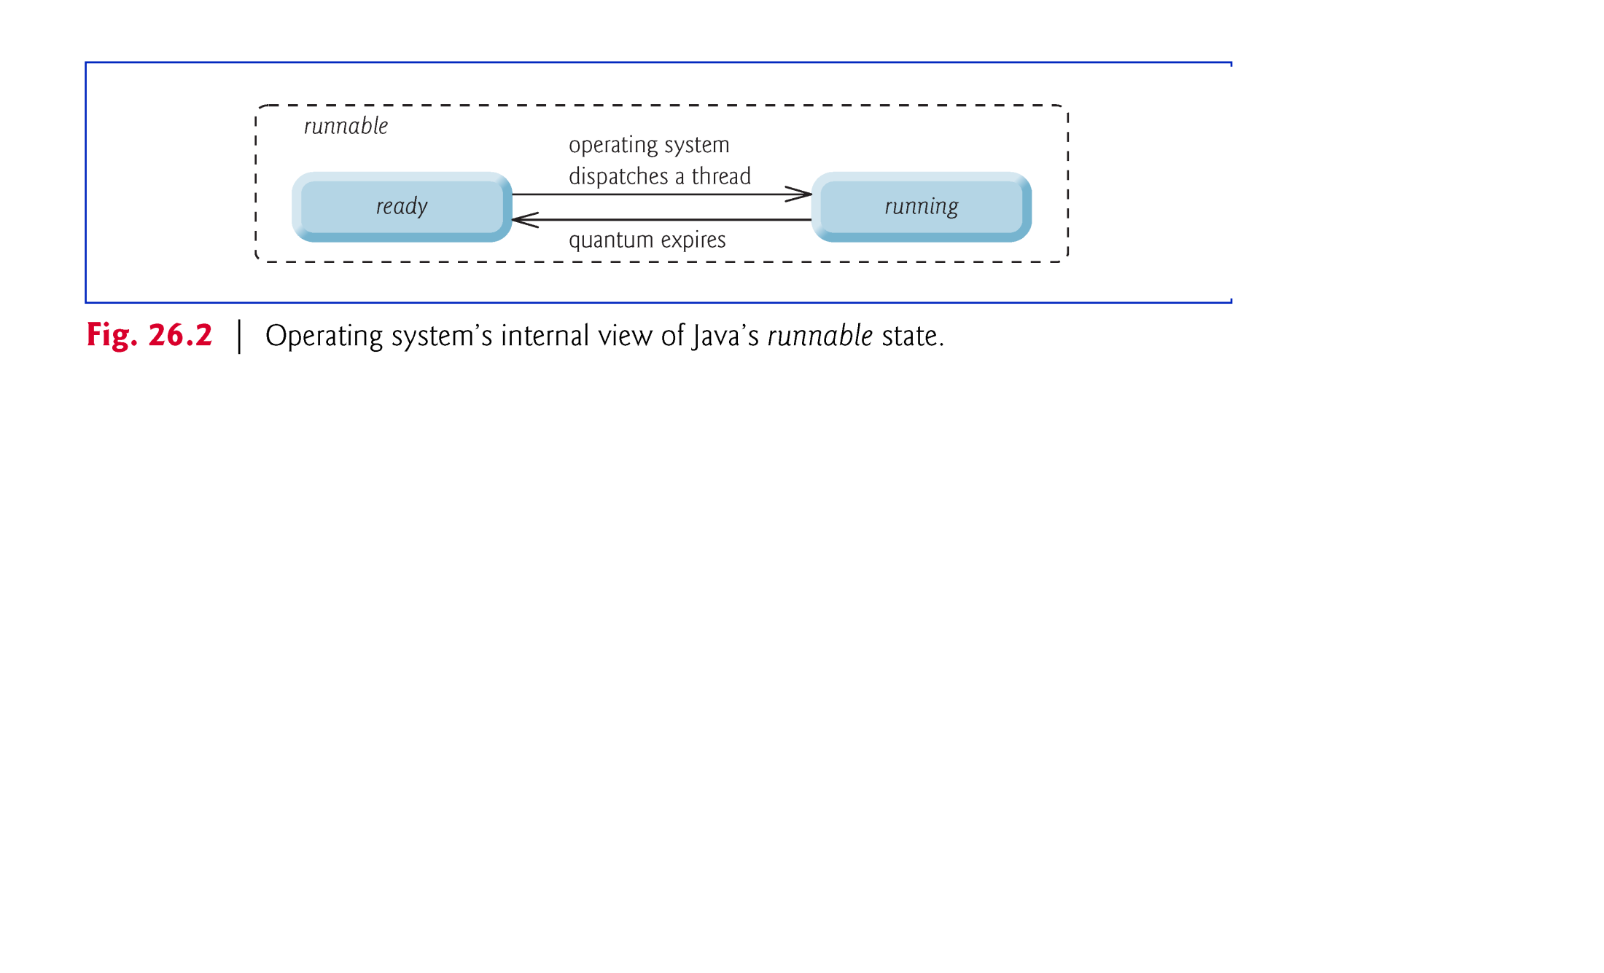
Operating System view at the threads
1-<number>

Slide 20
At the operating-system level, Java’s runnable state typically encompasses two separate states
  When a thread first transitions to the runnable state from the new state, it is in the ready state.
A ready thread enters the running state (i.e., begins executing) when the operating system assigns it to a processor—also known as dispatching the thread.
Typically, each thread is given a a quantum or timeslice by the OS in which to perform its task.
  The process that an OS uses to determine which thread to dispatch is called thread scheduling.
1-<number>

Slide 21
Example 1: Threads in Banking Application
Think of a thread as a little “worm” that reads your code and runs it step-by-step
We say that a thread “enters” a method of an object
alice
bob
BankAccount
BankAccount
balance
balance
BankApp
100
200
public class BankApp
{ …
public static void main( … )
{ … create alice and bob here …
// call alice and bob’s methods
alice.deposit( 100 );
bob.deposit( 200 );
int a = alice.getBalance();
int b = bob.getBalance();
System.out.println( a + “ “
+ b );
}
}
public class BankAccount
{ private int balance;
public BankAccount()
{
}
public int getBalance()
{ return balance;
}
public void deposit( int amount )
{ balance += amount;
}
}
public class BankAccount
{ private int balance;
public BankAccount()
{
}
public int getBalance()
{ return balance;
}
public void deposit( int amount )
{ balance += amount;
}
}
Whew!
That was a lot of work!
1-<number>

Slide 22
Creating and Executing Threads using the Class Thread
Creating threads
  Class Thread
Changing thread states
  Thread method start() called – thread starts execution
  Thread method sleep() called – thread sleeps for a set time interval then awakens
  Resuming the execution after the thread method sleep has been called is automatic

Slide 23
(cont.)
Represents a separate “worm” that can run code “at the same time” as other threads
start() method
  makes thread start to run code “in the background”
    i.e., main program still continues, but the thread starts running code “in parallel” with it
  each Thread instance can only be started once
    but it can be stopped and restarted many times
For each thing you want to do “in parallel”:
  create a separate instance of Thread class
  call start() on that instance
1-<number>

Slide 24
The run() method
Q: What code is executed?
  Ans: Code in the run() method
Q: Where is the run() method defined?
  Ans: Two possible ways
  Approach 1:
    extend Thread and override run()
  Approach 2:
    pass a Runnable object to Thread’s constructor
      Runnable is an interface composed of the run() method so any implementation will be a thread itself
    Thread t = new Thread( r );
    // where r implements Runnable interface
1-<number>

Slide 25
Example 2: Threads in Printing
PrintThread class extends class Thread
Thread data: name, timeDelay
Constructor sets name and timeDelay
run() method prints name twice but with a timeDelay in between the print statements
  use static method Thread.sleep(timeDelay)
  causes the current Thread to sleep for timeDelay milliseconds
1-<number>

Slide 26
Using run() method for PrintThread
public class PrintThread extends Thread
{ ...
  public void run()
  { System.out.println(this.name);
  try
  { Thread.sleep(this.timeDelay);
  }
  catch (InterruptedException e)
  {...
  }
  System.out.println(this.name);
  }
}
Note: Thread.sleep throws InterruptedException so you have to catch it. This exception is thrown when someone else (i.e., another thread) calls t.interrupt(). This is how you can forcefully wake up sleeping threads.
1-<number>

Slide 27
Using PrintThread
PrintThread t1,t2,t3;
// create the PrintThread instances
t1 = new PrintThread("tic",5000);
t2 = new PrintThread("tac",1000);
t3 = new PrintThread("toe",3000);
// start the Threads
t1.start();
t2.start();
t3.start();
System.out.println( “app” );
// expected output?
1-<number>

Slide 28
Now
4 threads
running
“in parallel”
app
t1.start();
t2.start();
t3.start();
System.out.println( “app” );
tic
PrintThreadApp
tac
toe
tac
toe
tic
t1
t2
t3
PrintThread
“tic”
5000
PrintThread
“tac”
1000
PrintThread
“toe”
3000
public class PrintThread
extends Thread
{ ...
public void run()
{ System.out.println( name );
try
{ Thread.sleep( timeDelay );
}
catch( InterruptedException e )
{
}
System.out.println( name );
}
}
public class PrintThread
extends Thread
{ ...
public void run()
{ System.out.println( name );
try
{ Thread.sleep( timeDelay );
}
catch( InterruptedException e )
{
}
System.out.println( name );
}
}
public class PrintThread
extends Thread
{ ...
public void run()
{ System.out.println( name );
try
{ Thread.sleep( timeDelay );
}
catch( InterruptedException e )
{
}
System.out.println( name );
}
}
wait 5000 ms
wait 1000 ms
wait 3000 ms
1-<number>

Slide 29
Running the threads “in parallel”
Note:
  app is printed first, even though it is the last line in PrintThreadApp
Why?
  Remember, threads run “at the same time”
  no guarantees on who goes first
Another example:
  Try running the code many times
  Do you always get the same output?
  Why not?
  Remember: no guarantees on order of thread execution
1-<number>

Slide 30
Creating and executing Threads using Runnable interface
Class PrintTask implements Runnable (line 5), so that multiple PrintTask instances can execute concurrently.
Thread static method sleep places a thread in the timed waiting state for the specified amount of time.
  Can throw a checked exception of type InterruptedException if the sleeping thread’s interrupt method is called.
The code in main executes in the main thread, a thread created by the JVM.
The code in the run method of PrintTask executes in the threads created in the main method.
When method main terminates, the program itself continues running because there are still threads that are alive.
  The program will not terminate until its last thread completes execution.

Slide 31
Example 3: Multithreaded Printing revisited
PrintTask class implements Runnable interface instead
  Attributes: sleepTime, taskName
  Initialization: Constructor sets initial values for attributes taskName and sleepTime
run() method from Runnable interface performs the main tasks of the thread
  printing the attribute taskName
  forcing the thread to enter sleeping state using static method Thread.sleep()
  causing the current thread to sleep for sleepTime milliseconds
1-<number>

Slide 32
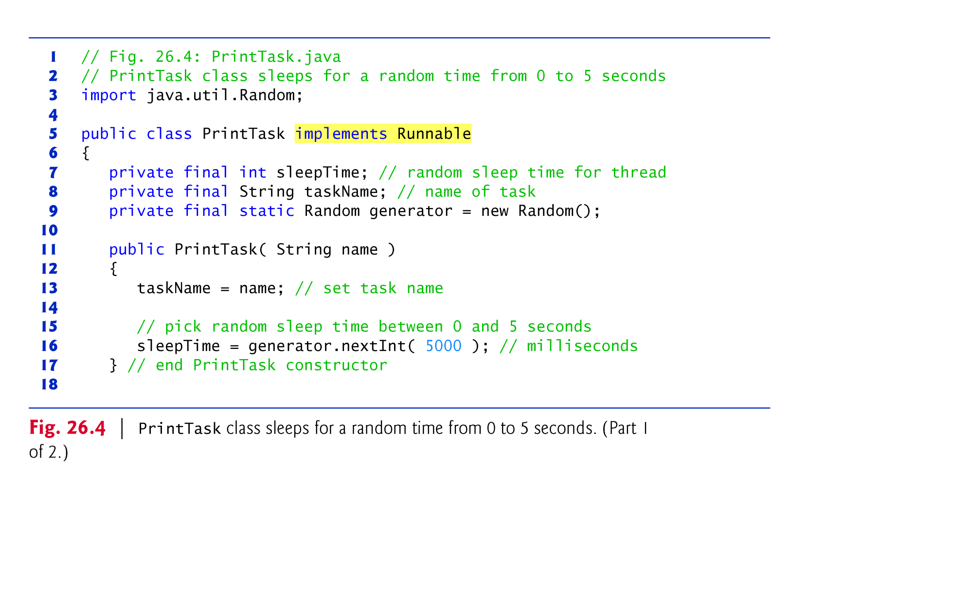
(C) 2010 Pearson Education, Inc. All rights reserved.

Slide 33
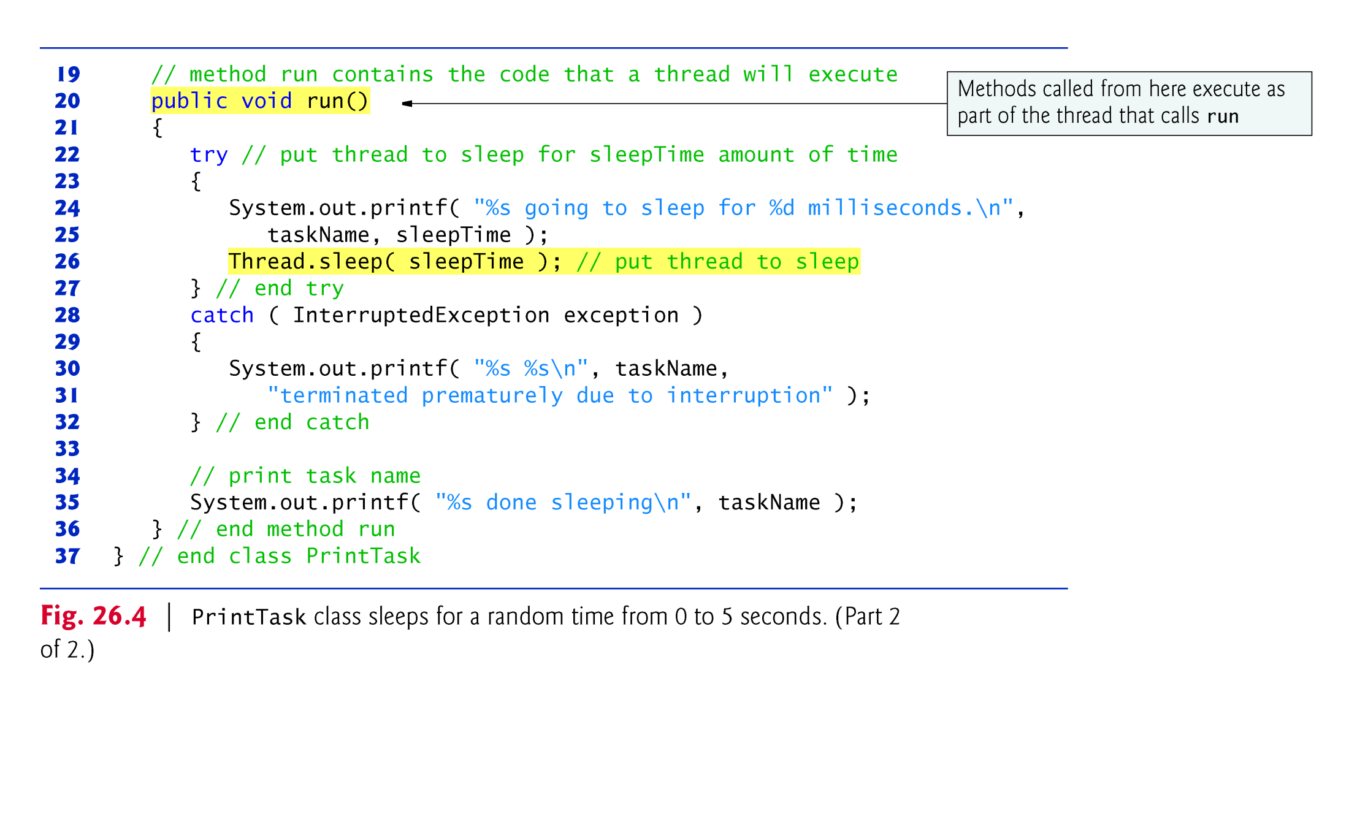
(C) 2010 Pearson Education, Inc. All rights reserved.

Slide 34
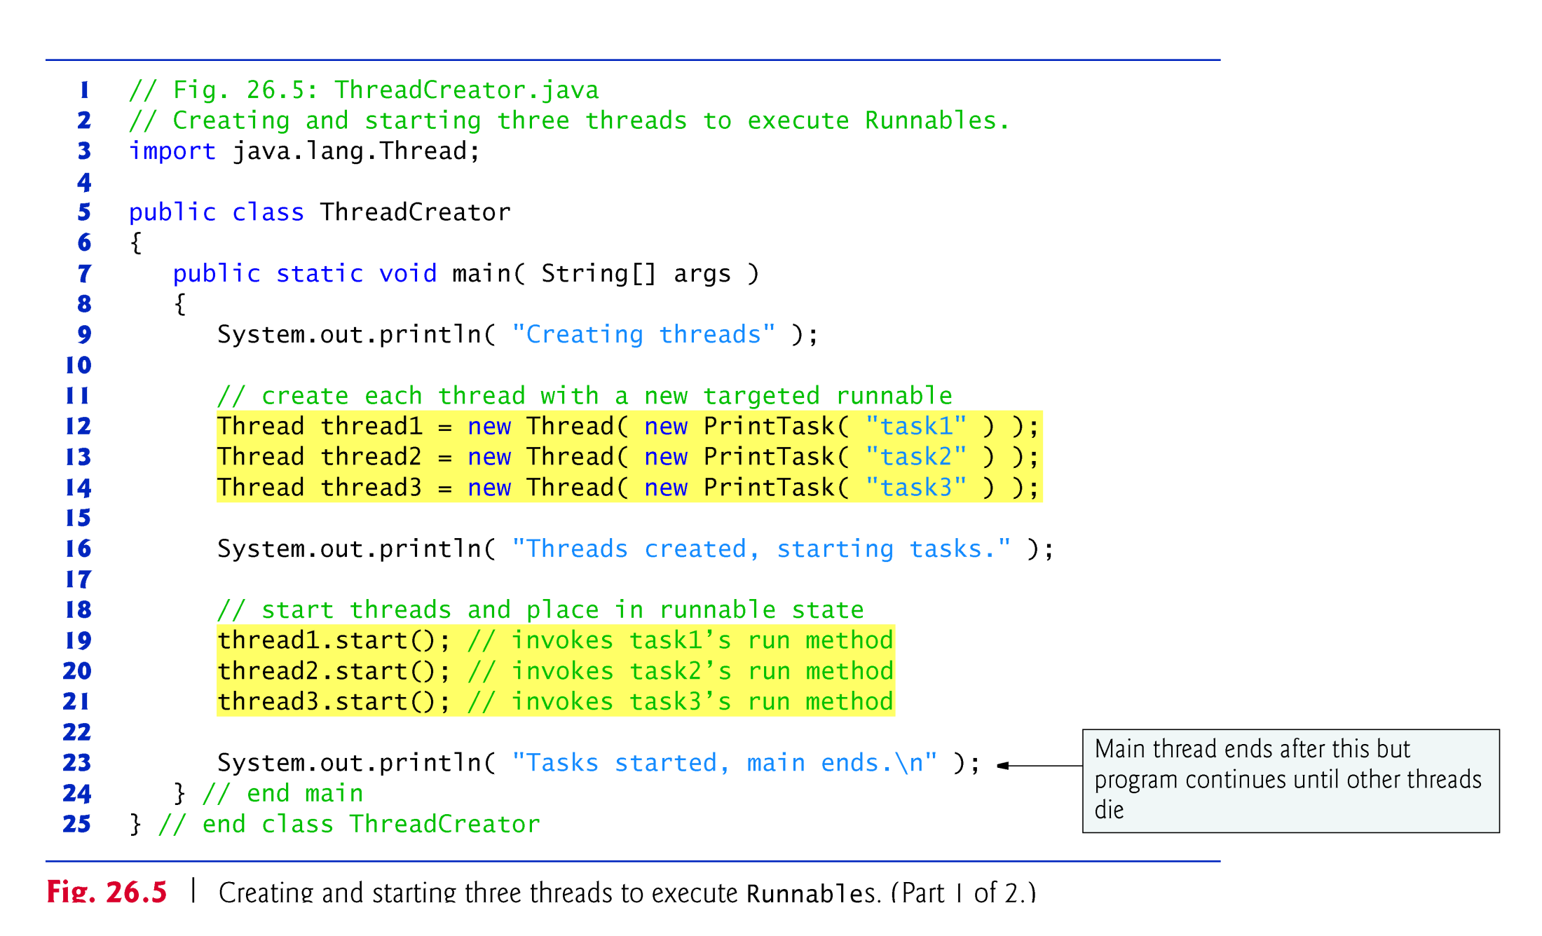
(C) 2010 Pearson Education, Inc. All rights reserved.

Slide 35
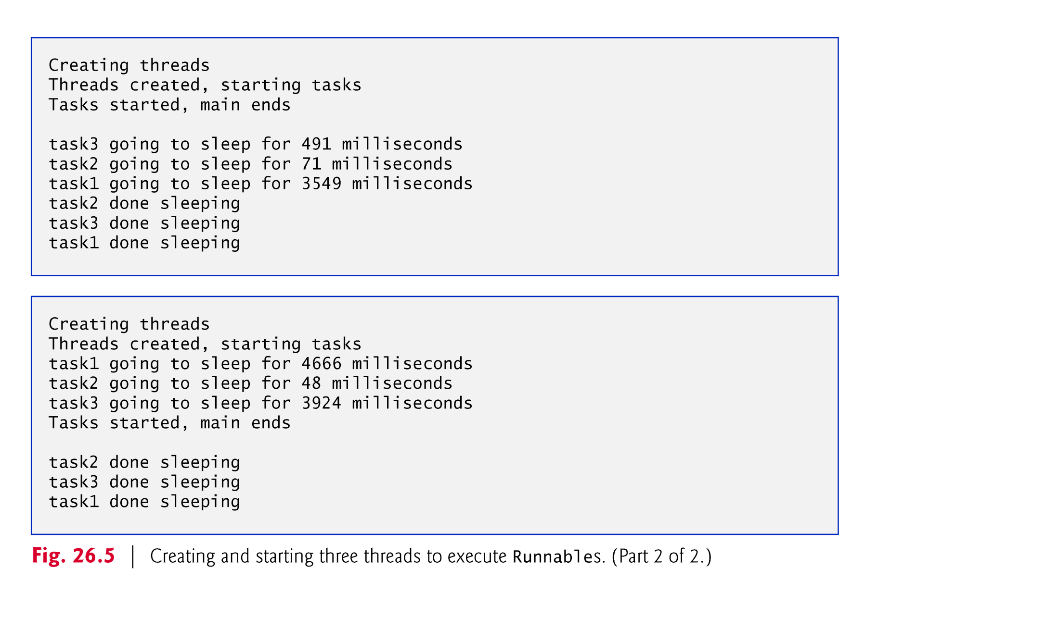
(C) 2010 Pearson Education, Inc. All rights reserved.

Slide 36
What’s the difference?
Example 2: PrintThread extends Thread class overwriting its method run()
  PrintThread object is a Thread object
  It defines its own run() method
  Like a “worm” object that carries out the work itself
Example 3: PrintTask implements Runnable interface which specifies the method run()
  We use a generic Thread instance instead
  run() is defined in PrintTask not in Thread
  Like having an “all-around worm”, and giving it an instruction book telling it what to do
Which approach is preferable?
  The second - sometimes you can’t extend Thread because the object with the run() method already extends something else, thus allowing multiple inheritance
1-<number>

Slide 37
LECTURE PLAN
  1 Processes and Threads
  2 Threads Lifecycle
  3 Multithreading in Java
  4 Multithreading with GUI
    GUI Support for Multithreading in Swing
    Example: Background use of Fibonacci number generator
1-<number>

Slide 38
Multithreading with GUI
All Swing applications have a single thread, called the event dispatch thread, to handle interactions with the application’s GUI components.
  Swing GUI components are not thread safe
  Thread safety in GUI applications is achieved by ensuring that Swing components are accessed from only one single thread - the event dispatch thread.
The Swing applications can be multithreaded, too - i.e., they can run several worker threads in parallel
  The worker threads can exchange data with the interface components via the event dispatch thread
  All tasks that require interaction with an application’s GUI are placed in an event queue and are executed sequentially by the event dispatch thread.

Slide 39
GUI support for multithreading in Swing
Java SE provides class SwingWorker (in package javax.swing) to perform long-running computations in a worker thread and to update Swing components via the event dispatch thread based on the results.
  Implements the Runnable interface, meaning that a SwingWorker object can be scheduled to execute in a separate thread.
Some common SwingWorker methods are described bellow.

Slide 40
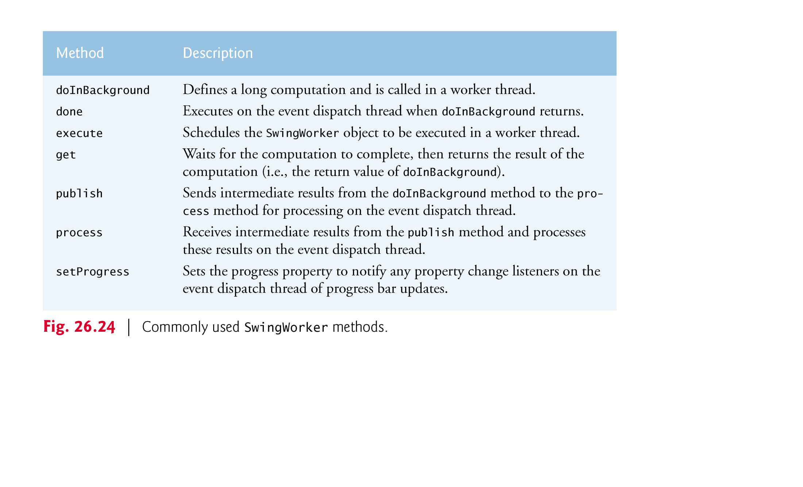
(C) 2010 Pearson Education, Inc. All rights reserved.

Slide 41
Example: Performing Computations in a Background Thread with result display in GUI
Class FibonacciNumbers runs in parallel two computational processes – a long and a short ones
  The background computation runs a long tread which calculates the nth Fibonacci number using recursion
  The foreground computation runs short thread which calculates one Fibonacci number based on the previous two.
Class FibonacciNumbers displays a window containing two sets of GUI components—one set to compute a Fibonacci number in a worker thread and another to get the next Fibonacci number in response to the user’s clicking a Jbutton.

Slide 42
Step 1: Cteating the Background Thread
Class BackgroundCalculator extends SwingWorker, overriding its methods doInBackground and done.
The class BackgroundCalculator defines the background thread using Java generic class SwingWorker<Long,Object> (line 8)
  The first type parameter indicates the type returned by the doInBackground method
  The second parameter indicates the type that is passed between the publish and process methods to handle intermediate results.
  Even we do not use publish and process in this example, we still use Object as the second type parameter of the class

Slide 43
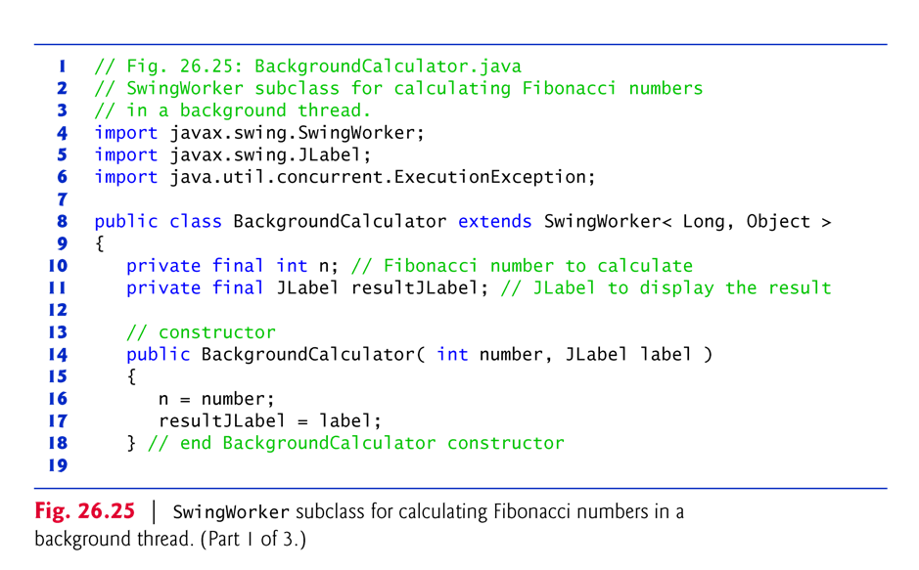
Defining the background thread using SwingWorker
(C) 2010 Pearson Education, Inc. All rights reserved.

Slide 44
Methods for invoking the background computational thread and for dispatching the result
Method doInBackground (lines 21–25) computes the nth Fibonacci number in a worker thread and returns the result.
Method done (lines 28–44) displays the result in a Jlabel Swing component

Slide 45
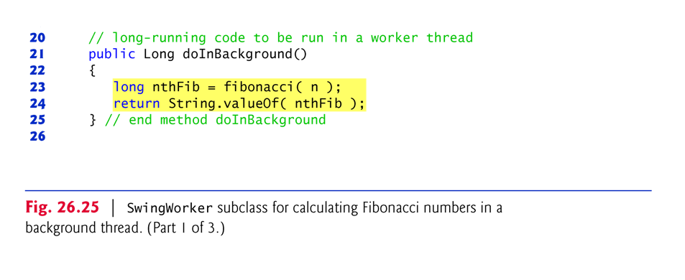
Defining method doInBackground
(C) 2010 Pearson Education, Inc. All rights reserved.

Slide 46
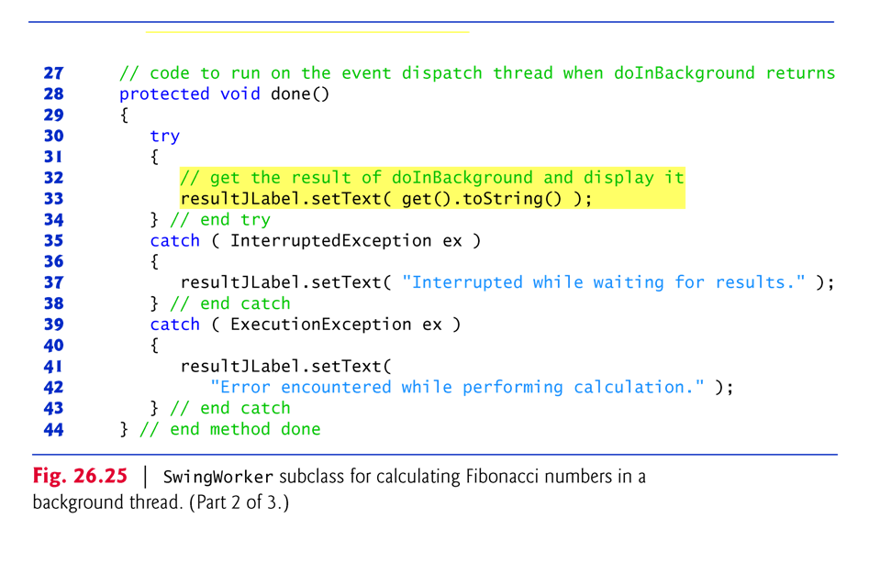
Defining method done
(C) 2010 Pearson Education, Inc. All rights reserved.

Slide 47
How the background thread works?
When method execute is called on a BackgroundCalculator object, the object is scheduled for execution in the worker thread.
When method doInBackground is called from the worker thread it invokes the fibonacci method (lines 47–53), passing instance variable n as an argument (line 23).
When fibonacci returns, method doInBackground receives the result and returns it to the worker thread

Slide 48
Methods for performing the computation included in the background thread
Method fibonacci(lines 47–54) computes the nth Fibonacci number using double recursion
It returns the results for further processing which will be organised in the corresponding short and long threads
This method can be replaced by any computationally intensive method – i.e., computing the nth prime

Slide 49
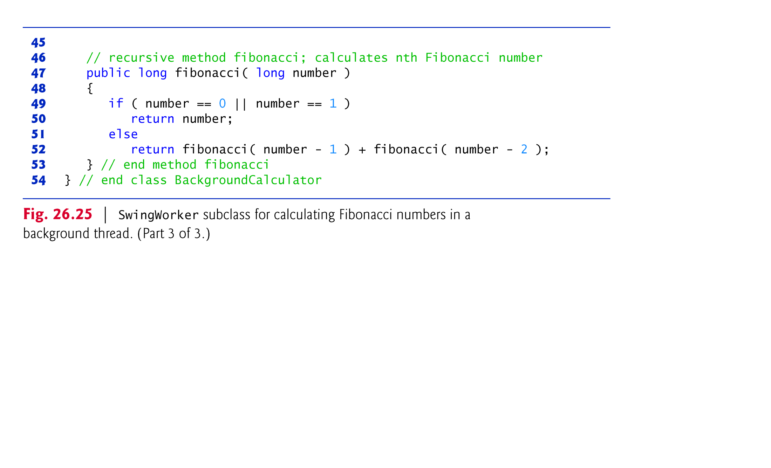
Method fibonacci() for computation of the nth Fibonacci number
(C) 2010 Pearson Education, Inc. All rights reserved.

Slide 50
Passing the result from the worker thread to the UI
After doInBackground returns, method done is called from the event dispatch thread.
  This method attempts to set the result JLabel to the return value of doInBackground by calling method get to retrieve the return value.
Method get waits for the result to be ready if necessary, but since we call it from method done, the computation will be complete before get is called.
(C) 2010 Pearson Education, Inc. All rights reserved.

Slide 51
Step 2: Defining the Computation in a Worker Thread
Class FibonacciNumbers displays a window containing two sets of GUI components—one set to compute a Fibonacci number in a worker thread and another to get the next Fibonacci number in response to the user’s clicking a Jbutton.
The events on the GUI are processed by two separate event listeners
  The background computation is initiated when you press the button Go
  The foreground computation is started when you press the button Next

Slide 52
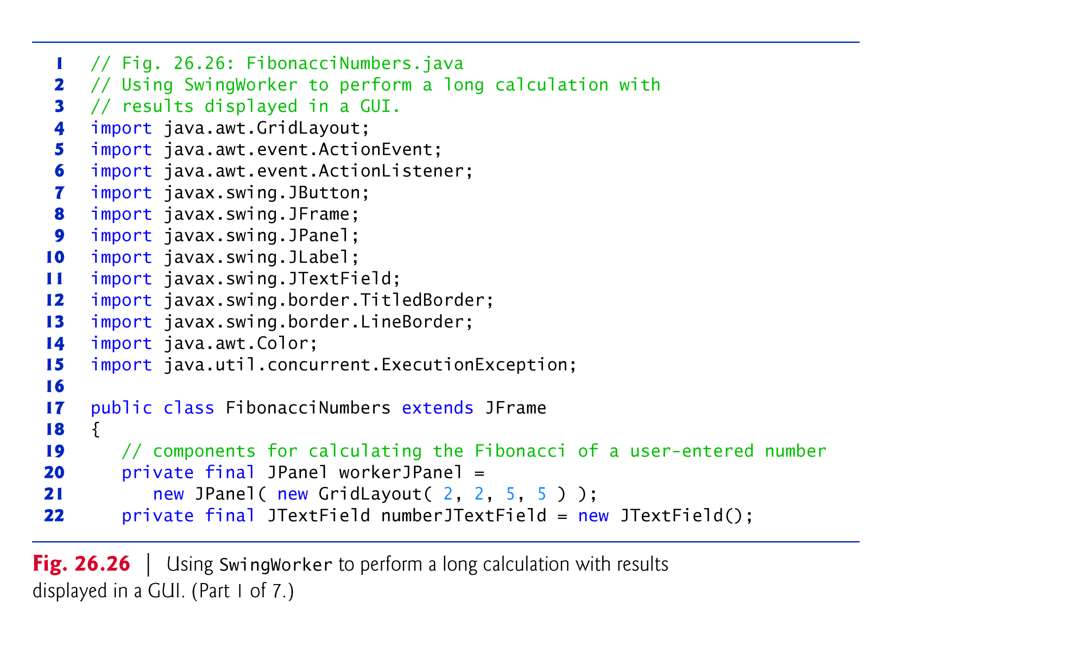
(C) 2010 Pearson Education, Inc. All rights reserved.

Slide 53
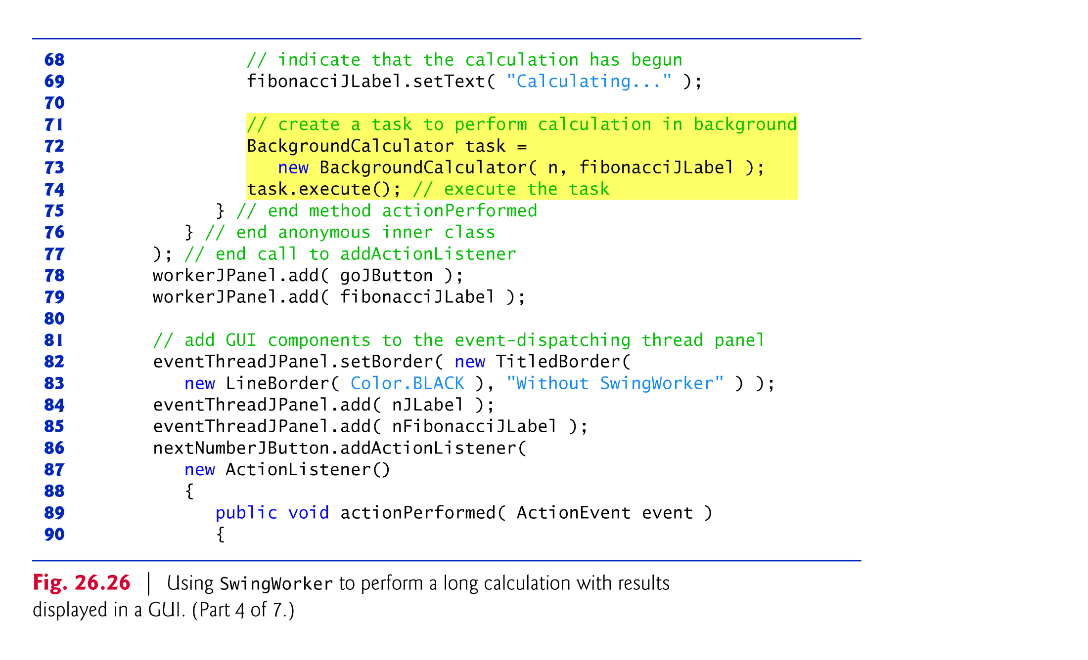
Creating the Background Thread inside the Background Thread Listener
(C) 2010 Pearson Education, Inc. All rights reserved.

Slide 54
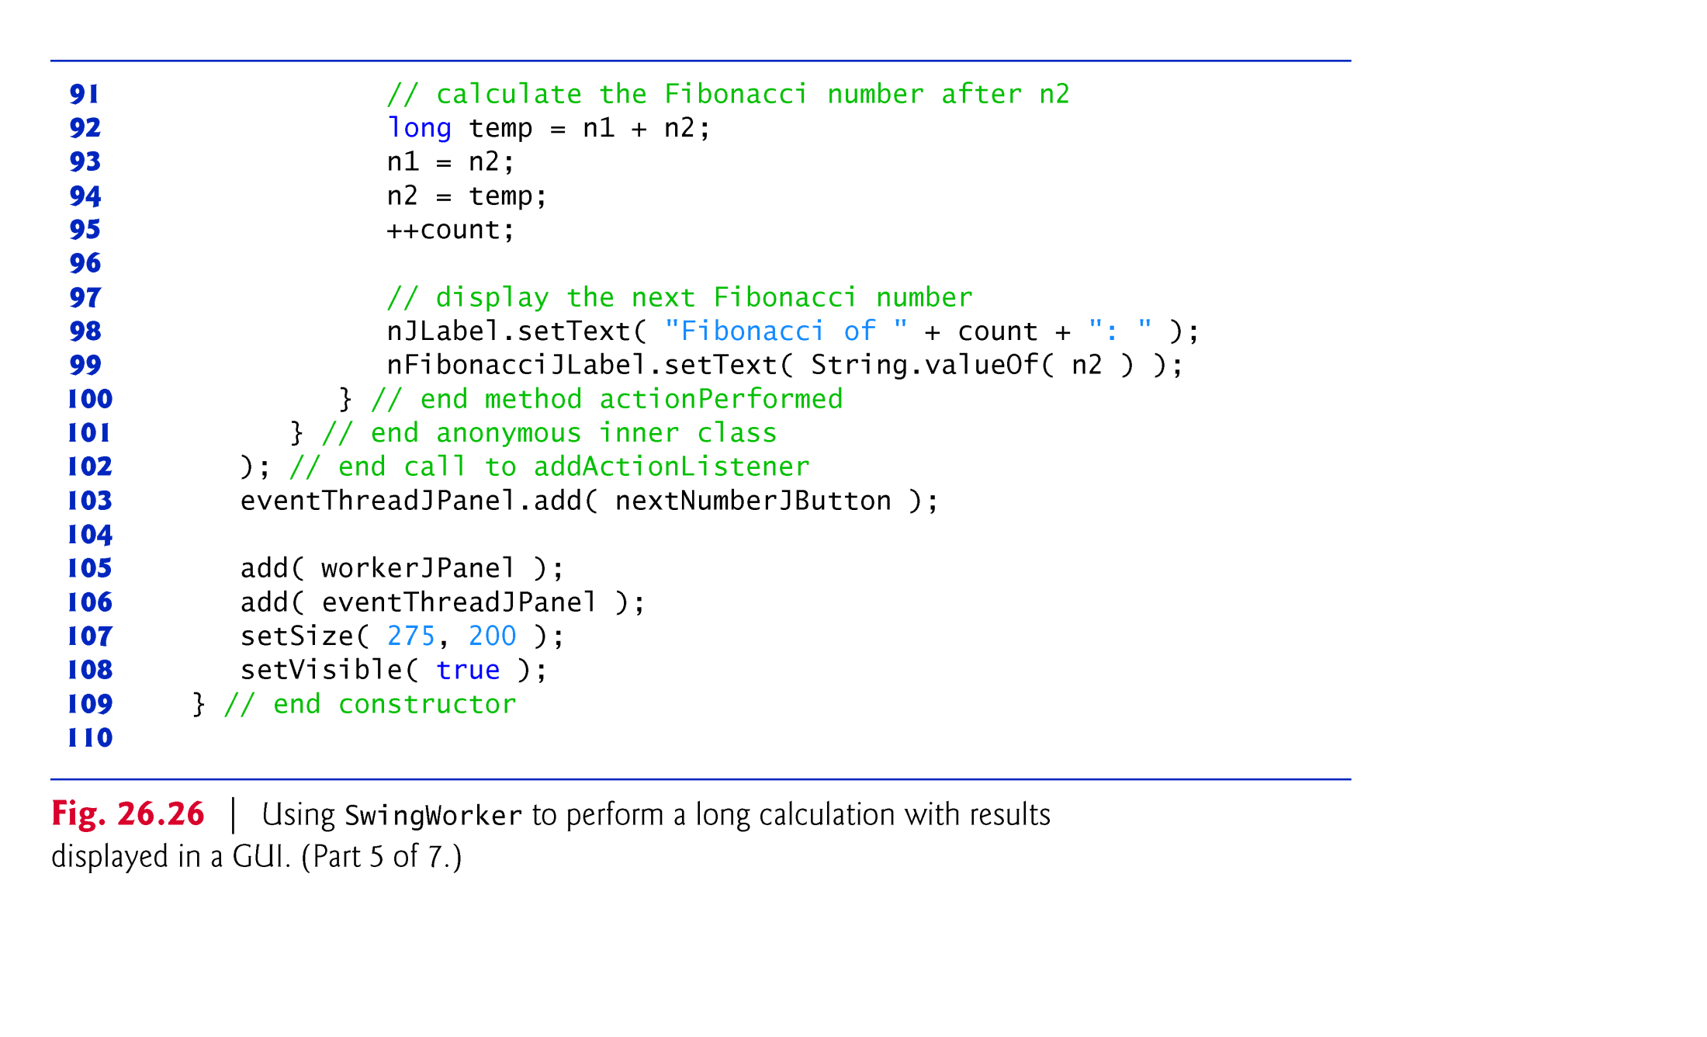
Creating the Foreground Thread inside the Foreground Thread Listener
(C) 2010 Pearson Education, Inc. All rights reserved.

Slide 55
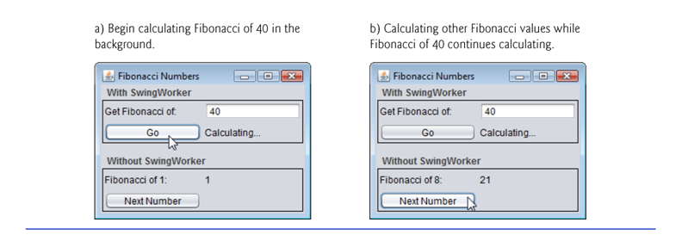
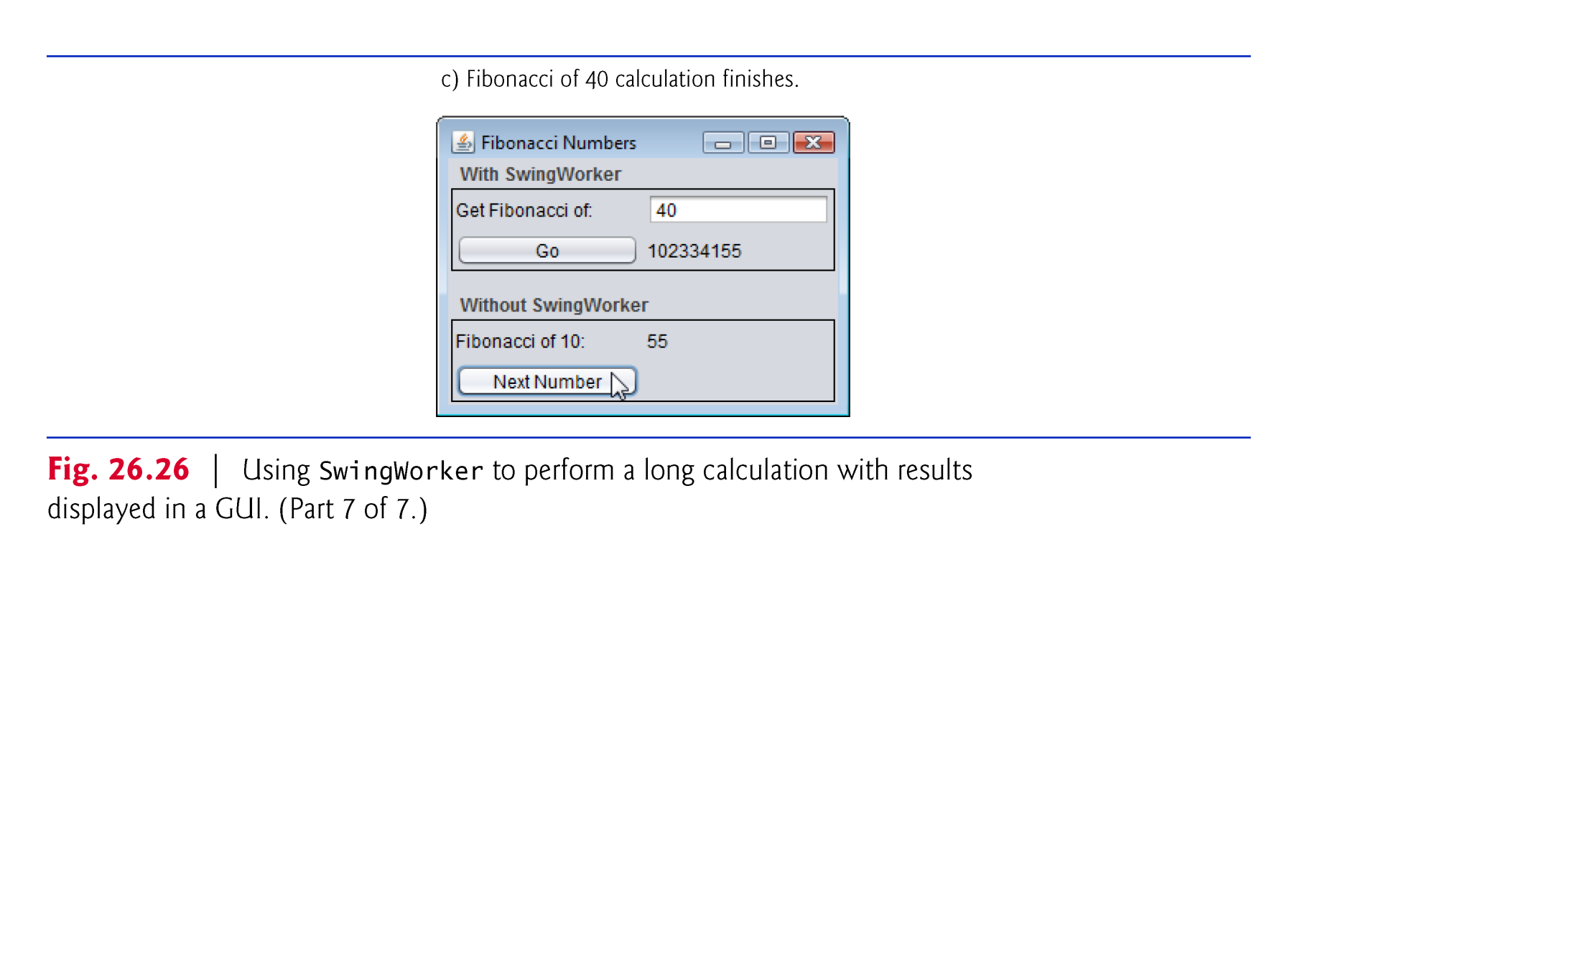
Executing the multithreaded application
(C) 2010 Pearson Education, Inc. All rights reserved.

Slide 56
On-line Java Thread Resources
Java Threads Tutorial
http://docs.oracle.com/javase/tutorial/essential/concurrency
Java Threads used with Java Swing
http://docs.oracle.com/javase/tutorial/uiswing/concurrency/index.html
Using Threads with Java ME
http://www.oracle.com/technetwork/systems/index-155545.html
Processes and Threads in Java Android
  http://developer.android.com/guide/components/processes-and-threads.html
1-<number>

